Slide 1
Costume Society Feedback
September 2014

Slide 2
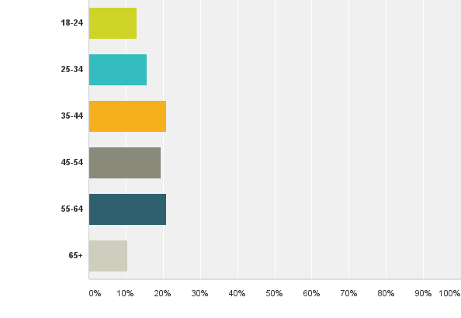
Q1: How old are you?
Answered: 77 Skipped: 0

Slide 3
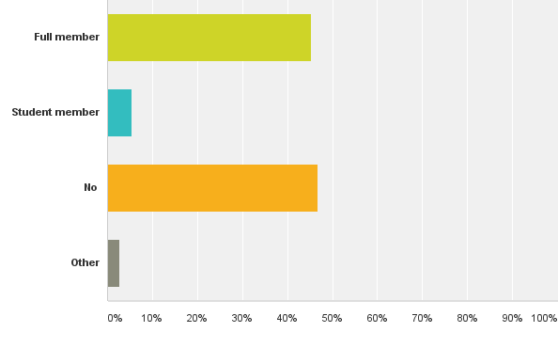
Q2: Are you a member of The Costume Society?
Answered: 75 Skipped: 2

Slide 4
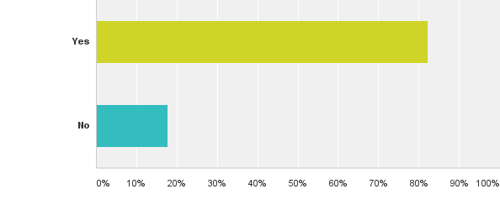
Q6: Have you visited our website www.costumesociety.org.uk?
Answered: 73 Skipped: 4

Slide 5
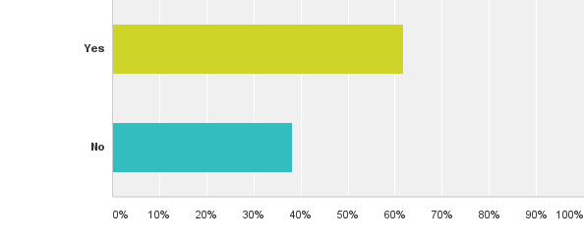
Q8: Are you a member of our Facebook group?
Answered: 68 Skipped: 9

Slide 6
What do you think the unique selling point of the Costume Society is?
Access to knowledge, information about costume
Elitist
Nurturing scholarship
Academic
Heritage Network
Eminence
Look seriously at costume
In depth Study
Independent
Ability to make connections with other like minded people
A place to learn from each other
National society
Appeals to professionals and enthusiasts
Shared appreciation

Slide 7
‘it is THE society for those who love all things costume history’
‘A platform and a community for a very special community’
‘I LOVE the society and if I had to hand on to only one of my hobbies it would be my desert island choice’
‘keep standards up without alienating non specialists’

Slide 8
How would you like the CS to celebrate its 50 year anniversary?
Reflect how the society has changed
Grants- lots of them!
Celebrate contemporary designers/dress researchers
Trips/visits to collections
Trips abroad
Conference with international speakers
Touring event
Increase visibility ‘by really drawing attention to itself’
Liaise with local groups to spread the word
Increase profile
Get members to share their dress memories of 1962
Collect memories on the website
Have a huge party!
Special edition publication
Memento for member to mark the award

Slide 9
How do you think we can attract younger members?
Visit and network with colleges/universities
Target fashion/drama/costume students and schools
Mentoring programme
Talks/study days for students/young professionals
Flexible memberships- half yearly? Rates for under 30s?
Talks with contemporary designers
Change the name
Get other bloggers to review your events
Good images
Competitions
Meet ups for young professionals
More engagement/comment around current fashion/fashion history debates
Affordability of events
Widen participation
Set up a focus/advisory group
Identify ‘connectors’
Have TED talks – five minute soap box at conferences
Get interns from events management to help with events
E newsletter
More social media

Slide 10
What would you like to see in the members only area?
Directories
Past costume journal
Place to share photos from members
Profiles of members
Forums to get advice and network
Information about grants
Open everything up
Information exchange
Networking opportunities
Inside secrets of garments

Slide 11
Conclusions
Older members vs new members
Scholarship vs enthusiast
Under 30s participation
Greater visibility
Being both national and connecting regionally
Build ways to connect people
Relevance to contemporary issues
Sharing knowledge and information
‘

